Slide 1

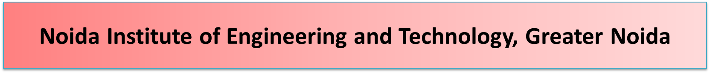
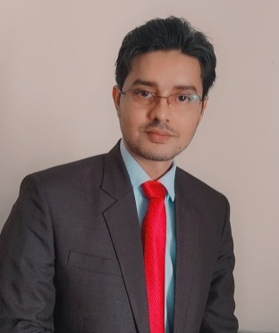


TQM Thinkers and Thoughts
Unit: 2
Subject Name – Total Quality Management
Faculty Name – Mr. Minhaj Nezami
Assistant Professor
Department - IT
Course – B. Tech 8th Semester

Slide 2


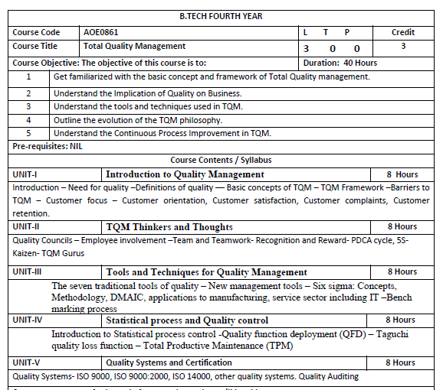

Slide 3

Contents
Course Objectives
Course Outcomes
Program Outcome
CO-PO Mapping
Program Specific Outcome
CO-PSO Mapping
Program Educational Objectives
Recap and Precap
Syllabus of Unit 2
Recap of Deming point
Objective of TQM
TQM Details.
Recap of TQM
Objective of Quality Councils
Quality Councils

Slide 4


Recap of Quality Councils
Objective of Quality Cost
Quality Cost
Recap of Quality Cost
Objective of Team
Team
Video links
Daily quiz
Weekly assignments
MCQs
Old question papers
Expected questions for university exam
Summary

Slide 5
Course Objectives
AOE0861.1 | To learn about common term Quality Concepts
AOE0861.2 | To know TQM Principle
AOE0861.3 | To understand the importance of different chart like P-charts and C-charts
AOE0861.4 | To know new term PDCE cycle, 5S,Kaizen
AOE0861.5 | To be aware about different ISO standards and JIT

Slide 6
Course Outcomes
AOE0861.1 | Define the Quality Concepts and Manufacturing Quality
AOE0861.2 | Conceptualize the term Quality Management and relate to this various TQM Principles
AOE0861.3 | Analyze the different Tools and Techniques and Control Charts
AOE0861.4 | Distinguish between Defects Diagnosis and Prevention term
AOE0861.5 | Coordinate IS0 and its concept to Quality Management

Slide 7
Program Outcomes
PROGRAM OUTCOME
1. Engineering knowledge
2. Problem analysis
3. Design/development of solutions
4. Conduct investigations of complex problems
5. Modern tool usage
6. The engineer and society
7. Environment and sustainability
8. Ethics
9. Individual and team work
10. Communication
11. Project management and finance
12. Life-long learning

Slide 8
CO-PO Mapping
CO | PO1 | PO2 | PO3 | PO4 | PO5 | PO6 | PO7 | PO8 | PO9 | PO10 | PO11 | PO12
AOE0861.1 | 3 | 3 | 2 | 2 | 1 | 2 | 2 | 1 | 1 | 1 | 2 | 3
AOE0861.2 | 3 | 3 | 3 | 3 | 2 | 2 | 2 | 1 | 1 | 1 | 2 | 3
AOE0861.3 | 3 | 3 | 2 | 3 | 3 | 2 | 2 | 1 | 2 | 1 | 2 | 3
AOE0861.4 | 3 | 2 | 3 | 2 | 2 | 2 | 2 | 1 | 2 | 1 | 3 | 3
AOE0861.5 | 3 | 2 | 3 | 2 | 2 | 2 | 2 | 1 | 2 | 1 | 2 | 3
Avg | 3 | 2.6 | 2.6 | 2.4 | 2 | 2 | 2 | 1 | 1.6 | 1 | 2.2 | 3

Slide 9
PROGRAM SPECIFIC OUTCOME
On successful completion of graduation degree, The computer Science & Engineering graduates will be able to:
PSO1: identify, analyze real world problems and design their ethical solutions using artificial intelligence, robotics, virtual/augmented reality, data analytics, block chain technology, and cloud computing.
PSO2: design and develop the hardware sensor devices and related interfacing software systems for solving complex engineering problems.
PSO 3: understand inter-disciplinary computing techniques and to apply them in the design of advanced computing.
PSO 4: conduct investigation of complex problem with the help of technical, managerial, leadership qualities, and modern engineering tools provided by industry sponsored laboratories.

Slide 10
CO-PSO Mapping
CO | PSO1 | PSO2 | PSO3
AOE0861.1 | 3 | 2 | 3
AOE0861.2 | 3 | 2 | 2
AOE0861.3 | 3 | 2 | 3
AOE0861.4 | 3 | 3 | 3
AOE0861.5 | 3 | 2 | 3
Avg | 3 | 2.2 | 2.8

Slide 11
PROGRAM EDUCATIONAL OBJECTIVES
PEO 1: To have an excellent scientific and engineering breadth so as to comprehend, analyze, design and provide sustainable solutions for real-life problems using state-of-the-art technologies.
PEO 2: To have a successful career in industries, to pursue higher studies or to support entrepreneurial endeavors and to face the global challenges.
PEO 3:To have an effective communication skills, professional attitude, ethical values and a desire to learn specific knowledge in emerging trends, technologies for research, innovation and product development and contribution to society.
PEO 4: To have life-long learning for up-skilling and re-skilling for successful professional career as engineer, scientist, entrepreneur and bureaucrat for betterment of society.

Slide 12
RECAP AND PRECAP
RECAP
1. Who is customer?
2. What is quality?
3. What is guarantee?
PRECAP
1. What is TQM
2. Modern approach
3. Principles

Slide 13
SYLLABUS OF UNIT 2
TQM Thinkers and Thoughts:
Quality Councils – Employee involvement –Team and Teamwork- Recognition and Reward- PDCA cycle, 5S-Kaizen- TQM Gurus

Slide 14
RECAP OF DEMING POINT
Deming 14 point is implemented in an organization by management to enhance quality.

Slide 15
Objective of TQM
The purpose of TQM is to provide quality by participation of stakeholder.

Slide 16
Introduction (CO2)
Total - made up of the whole
Quality - degree of excellence a product or service provides
Management - act, art or manner of planning, controlling
and directing.
Therefore, TQM is the art of managing the whole to achieve excellence.

Slide 17
The concept of TQM (CO2)
Produce quality work the first time.
Focus on the customer.
Have a strategic approach to improvement.
Improve continuously.
Encourage mutual respect and teamwork.

Slide 18
Various Definitions (CO2)
Total quality management (TQM) has been defined as an integrated organizational effort designed to improve quality at every level.
The process to produce a perfect product by a series of measures require an organized effort by the entire company to prevent or eliminate errors at every stage in production is called total quality management.
According to international organization for standards defined tqm as, “TQM is a management approach for an organization, centered on quality, based on the participation of all its members and aiming at long-term success through customer satisfaction and benefits to all members of the organization and society

Slide 19
Characteristics of TQM (CO2)
Adopting and communicating management
Committed management
Closer customer relations
Closer provider relations
Benchmarking
Increased training
Open organization
Employee empowerment
Flexible production
Process improvements
Process measuring

Slide 20
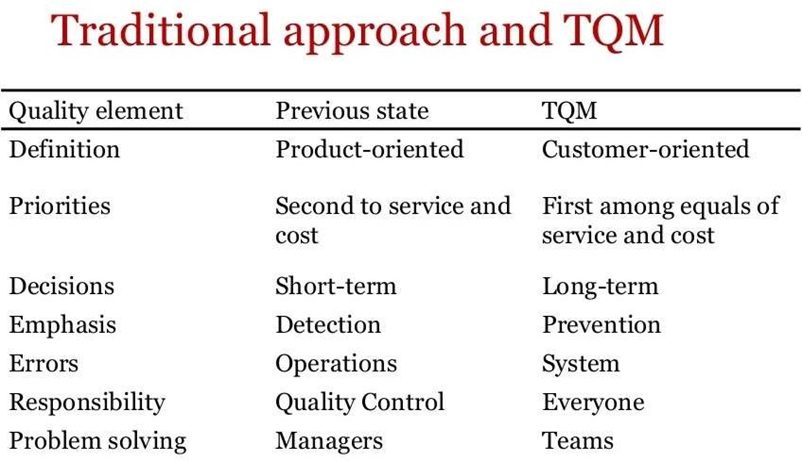
Traditional Approach and TQM (CO2)

Slide 21
Principles of TQM (CO2)
Produce quality work the first time and every time
Focus on the customer
Have a strategic approach to improvement
Improve continuously
Encourage mutual respect and teamwork

Slide 22
The key elements of TQM (CO2)
Focus on the customer
Employee involvement
Continuous improvement

Slide 23

Focus on the customer (CO2)
It is important to identify the organization’s customers.
External customers consume the organization’s product or service.
Internal customers are employees who receive the output of other employees.

Slide 24

Employee Involvement (CO2)
Quality is considered the job of all employees employees should be involved in quality initiatives.
Front line employees are likely to have the closest contact with external customers and thus can make the most valuable contribution to quality.
Therefore, employees must have the authority to innovate and improve quality.

Slide 25
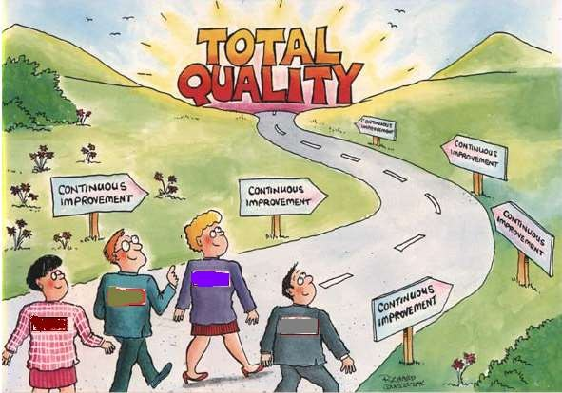
Continuous Improvement (CO2)

Slide 26
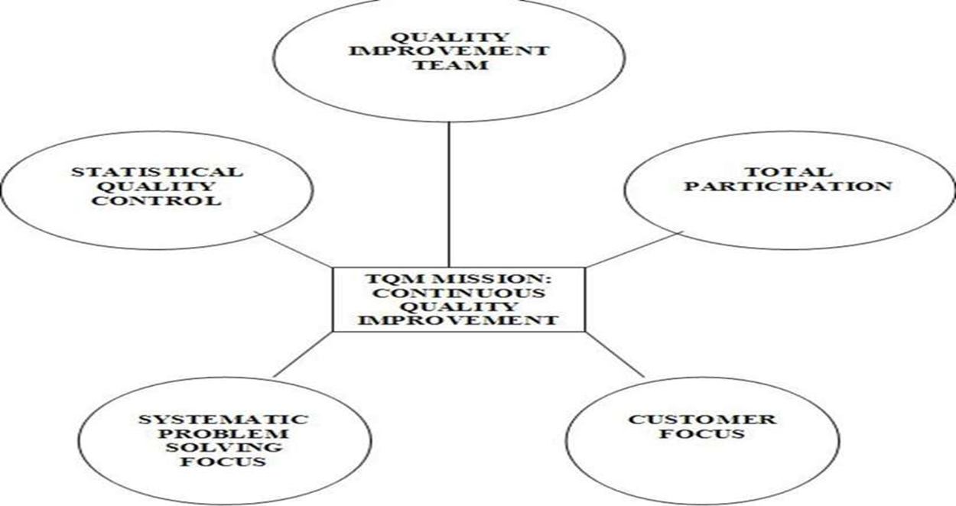
Continuous Improvement (CO2)

Slide 27
Continuous Improvement (CO2)
The quest for quality is a never-ending process in which people are continuously working to improve the performance, speed and number of features of the product or service.
Continuous improvement means that small, incremental improvement that occurs on a regular basis will eventually add up to vast improvement in quality.
TQM is the management process used to make continuous improvements to all functions.
TQM represents an ongoing, continuous commitment to improvement.
The foundation of total quality is a management philosophy that supports meeting customer requirements through continuous improvement.

Slide 28
Continuous Process Improvement (CO2)
View all work as process – production and business.
Process – purchasing, design, invoicing, etc.
Inputs – process – outputs.
Process improvement – increased customer satisfaction.
Improvement – 5 ways:
reduce resources, reduce errors, meet expectations of downstream customers, make process safer, make process more satisfying to the person doing

Slide 29
TQM System (CO2)
Continuous Improvement
Customer Focus
Process Improvement
Total Involvement
Leadership
Education and Training
Supportive structure
Communications
Rewards and recognition
Measurement

Slide 30
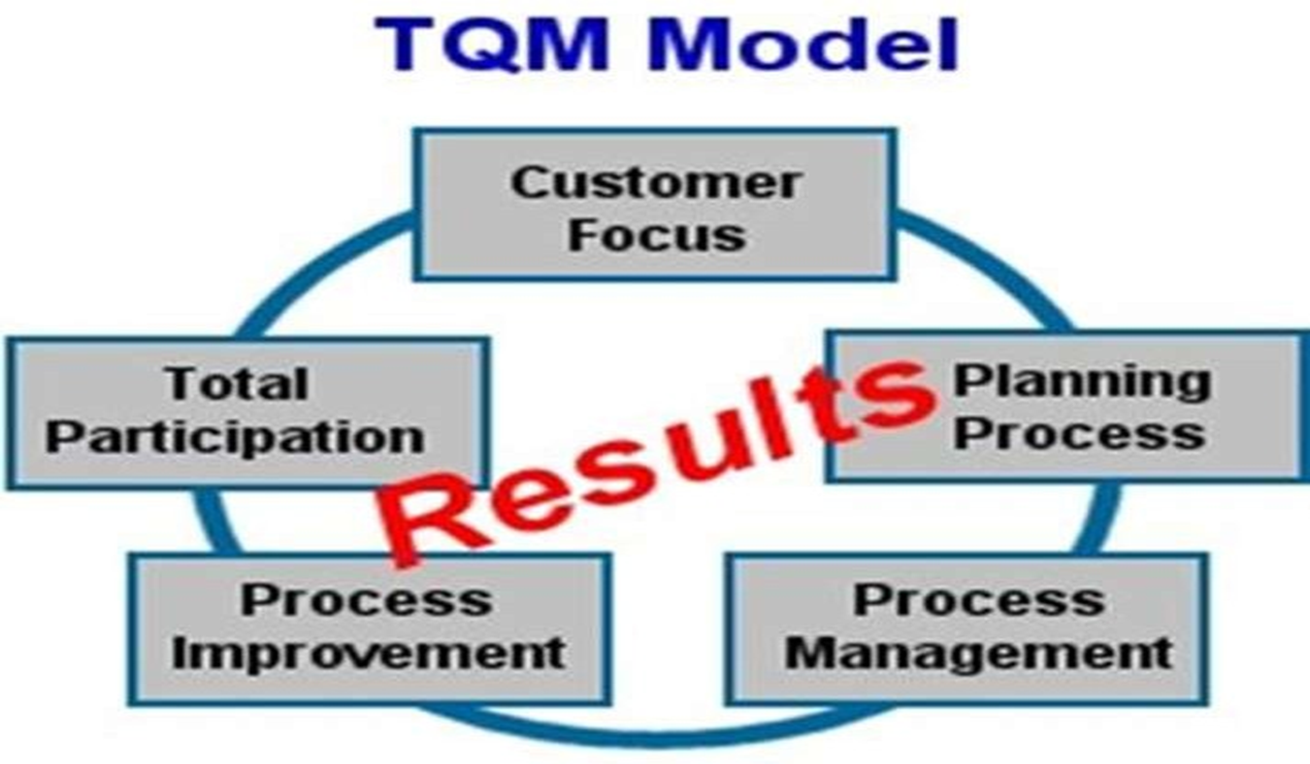
A model for organization management (CO2)

Slide 31
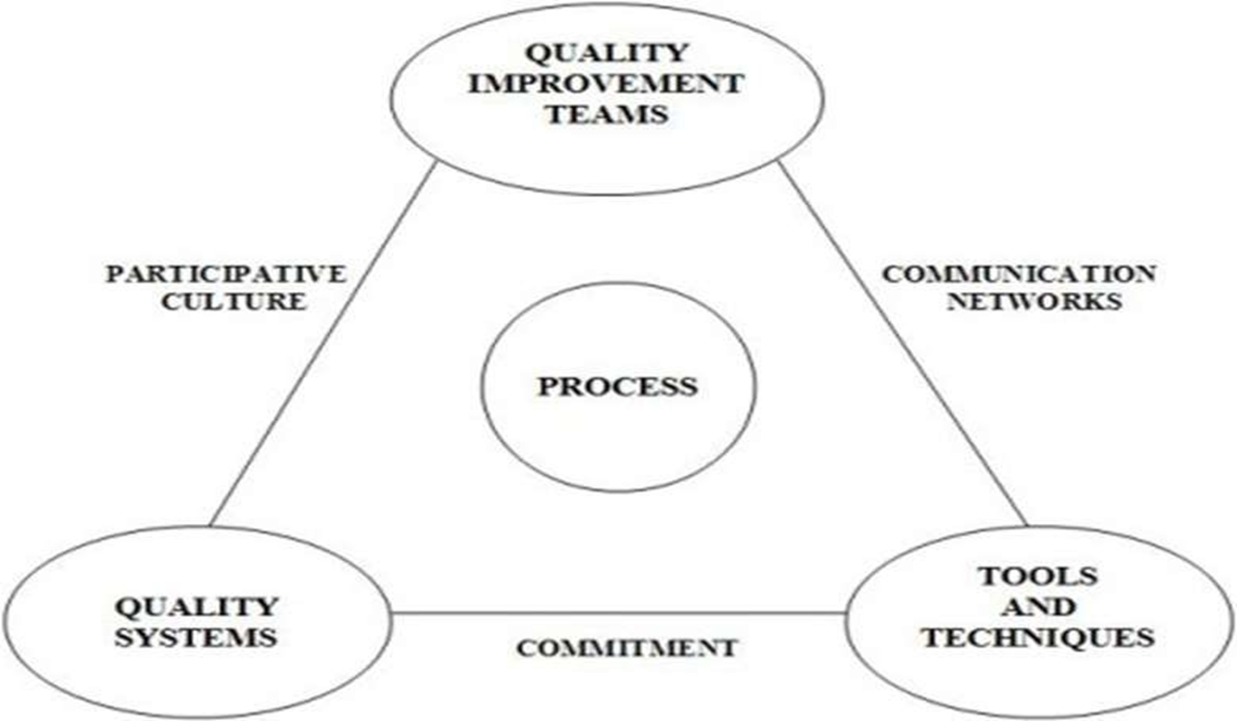
Models of TQM (CO2)

Slide 32
Benefits Of TQM (CO2)
Improved quality
Employee participation
Team work
Working relationships
Customer satisfaction
Employee satisfaction
Productivity
Communication
Profitability
Market share

Slide 33
Benefits of Total Quality Management (CO2)
Financial benefits include lower costs, higher returns on sales and investment, and the ability to charge higher rather than competitive prices.
Improved access to global markets, higher customer retention levels, less
Time required to develop new innovations, and a reputation as a quality firm.
Total quality management (TQM) is one such approach that seeks to improve quality and
Performance which will meet or exceed customer expectations.

Slide 34
Advantages of TQM (CO2)
Improves reputation- faults and problems are spotted and sorted quicker.
Higher employee morale- workers motivated by extra responsibility, team work and involvement indecisions of TQM.
Lower cost.
Decrease waste as fewer defective products and no need for separate.

Slide 35
Disadvantages of TQM (CO2)
Initial introduction cost.
Benefits may not be seen for several years.
Workers may be resistant to change

Slide 36
Recap of TQM
TQM is frame work for customer satisfaction and benefits to all members of the organization and society.

Slide 37
Objective of Quality Council
Develop the strategic long-term plan with goals and the annual quality improvement program with objectives

Slide 38
Quality Councils (CO2)
A body of senior managers representing the main functional areas and departments within a firm and quality specialists who meet periodically to identify quality problems and devise appropriate solutions to these problems. This may include setting-up a quality improvement
To deal with a particular quality problem. Organizations need to build quality culture in the organization. For this purpose, Quality council is established to provide over all direction. Quality Council is the instrument for maintaining the idea of never-ending quality improvement. It is driver for the TQM engine.

Slide 39
Quality Councils (CO2)
STRUCTURE OF QC:
Quality council is composed of,
1.Chief Executive Officer
2.Senior managers of functional areas (marketing, finance, HR,
Quality)
3.Coordinator/consultant (big organizations prefer coordinator
while small organizations prefer consultant)
4.Union representative
5.Front-line representatives

Slide 40
Quality Councils (CO2)
COORDINATOR
Coordinator is necessary to perform some of the important duties. The person selected for this position should be social, active and resourceful. He will report to CEO.
Duties of coordinator
Coordinator's duties are to, build two way trust convey team needs to the council and convey expectations of council to teams brief the council on progress of teams ensure that the teams are empowered and know their duties assist the team leaders share the lessons learned among the teams
In smaller organizations where managers may be responsible for more than one functional area, the number of members will be smaller. Also, a consultant would most likely be employed rather than a coordinator.

Slide 41
Quality Councils (CO2)
In general, the duties of the quality council are to:
Develop, with input from all personnel, the core values, vision statement, mission statement, and quality policy statement.
Develop the strategic long-term plan with goals and the annual quality improvement program with objectives.
Create the total education and training plan.
Determine and continually monitor the cost of poor quality.
Determine the performance measures for the organization, approve those for the functional area, and monitor them.

Slide 42
Quality Councils (CO2)
Continually determine those projects that improve the processes, particularly those that affect external and internal customer satisfaction.
Establish multifunctional project and departmental or work group teams and monitor their progress.
Establish or revise the recognition and reward system to account for the new way of doing business.

Slide 43
EMPLOYEE EMPOWERMENT(CO2)
Empowerment means giving people authority to make decisions based on what they feel is right, have control over their work, take risks and learn from mistakes, and promote change.
Empowerment is the process of enabling or authorizing an individual to think, behaves, take action, and control work and decision making in autonomous ways. This means leaders and managers relinquishing some of their powers that they previously held in terms of decision-making.
Empowerment diffuses decision making to employees so that employees make decisions regarding what they do and how they do it. Empowering employees is giving employees ‘ownership of their job.

Slide 44
EMPLOYEE EMPOWERMENT(CO2)
Benefits of employee empowerment
Improved morale
Involving employees in decisions and policy changes that directly affect their job while also empowering employees to be more autonomous greatly improves company morale at large.
Increased productivity
Quality management practices also translate into increased productivity
Team cohesion
Employee empowerment fosters better relationships between employees and with their managers, as employees that are given more independence tend to form better working relationships.
Innovation
Employee empowerment cultivates innovation as employees that have a stake in company growth and sustainability will offer more ideas and problem solving solutions when solutions arise.

Slide 45
Recap of quality council
Quality council is established to provide over all direction. Quality Council is the instrument for maintaining the idea of never-ending quality improvement. It is driver for the TQM engine.

Slide 46
Objective of Quality Cost
The aim of quality cost is to preventing, detecting, and remediating product issues related to quality.

Slide 47
Quality Cost (CO2)
Quality costs are the costs associated with preventing, detecting, and remediating product issues related to quality. Quality costs do not involve simply upgrading the perceived value of a product to a higher standard.
Instead, quality involves creating and delivering a product that meets the expectations of a customer. Thus, if a customer spends very little for an automobile, he will not expect leather seats and air conditioning - but he will expect the vehicle to run properly. In this case, quality is considered to be a vehicle that functions, rather than a luxury experience.

Slide 48

Quality costs fall into four categories, which are:
Prevention costs. You incur a prevention cost in order to keep a quality problem from occurring. It is the least expensive type of quality cost, and so is highly recommended.
Prevention costs can include proper employee training in assembling products and statistical process control (for spotting processes that are beginning to generate defective goods), as well as a robust product design and supplier certification.
A focus on prevention tends to reduce preventable scrap costs, because the scrap never occurs.
Appraisal costs. As was the case with a prevention cost, an appraisal cost is incurred in order to keep a quality problem from occurring. This is done through a variety of inspections.

Slide 49

The least expensive is having production workers inspect both incoming and outgoing parts to and from their workstations, which catches problems faster than other types of inspection. Other appraisal costs include the destruction of goods as part of the testing process, the depreciation of test equipment, and supervision of the testing staff.
Internal failure costs. An internal failure cost is incurred when a defective product is produced. This appears in the form of scrapped or reworked goods. The cost of reworking goods is part of this cost.
External failure costs. You also incur an external failure cost when a defective product was produced, but now the cost is much more extensive, because it includes the cost of product recalls, warranty claims, field service, and potentially even the legal costs associated with customer lawsuits. It also includes a relatively unquantifiable cost, which is the cost of losing customers.

Slide 50
Quality costs can arise anywhere in a company. There may be product design issues that begin in the engineering department, as well as manufacturing problems that can create product flaws. Further, the procurement department may acquire substandard components that result in product flaws.
In addition, the order entry department may have incorrectly entered a customer order, so that the customer receives the wrong product. These issues all result in quality costs.
Quality costs can comprise a major portion of the total expenses of a business, though they are hidden within its normal cost recording system, which is oriented more toward recording by responsibility center than by quality issue. The mitigation of quality issues can greatly increase the profitability of a business, as well as enhance the level of customer retention.

Slide 51
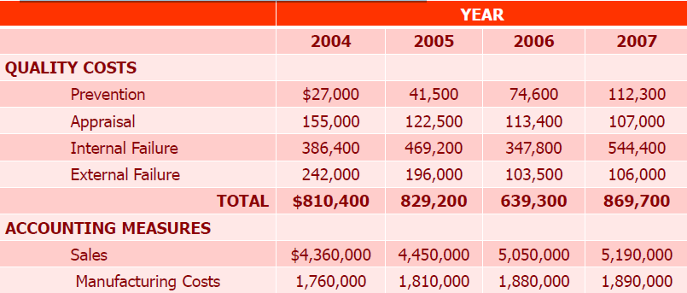
Example: The H&S Motor Company manufactures small motors (e.g.,3hp) for use in lawn mowers and garden equipment. The company instituted a quality management program in 2004 and has recorded the following quality cost data and accounting measures for four years.
The company wants to assess its quality–assurance program and develop quality index numbers using sales and manufacturing cost bases for the four year period.

Slide 52
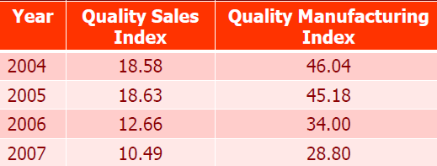
Quality Index = [(Total Quality Costs) / Base]*100
The Index Number for 2004 sales is: Quality Cost per sale
= [(810,400/4,360,000)]*100 = 18.58%
“The H&S Company quality index numbers reflect dramatically improved quality during the four year period”
Quality Costs as a Proportion of both sales & manufacturing costs improved
significantly
Quality Index Numbers are useful in showing trends in product quality over time and reflecting the impact of product quality relative to accounting measures with which managers are usually familiar.

Slide 53
Recap of Quality cost
Quality costs can comprise a major portion of the total expenses of a business, though they are hidden within its normal cost recording system, which is oriented more toward recording by responsibility center than by quality issue.

Slide 54
Objective of Teamwork
Teamwork is a fundamental element of total quality because it is organizations not individuals that produce products and provide services which makes peak performance and continual improvements.

Slide 55
Team (CO2)
Definition of a team
A team is defined as a group of people with a common, collective goal. This goal aspect is very critical in the team. An example of teamwork succeeding over individualism is the No Name Defense of the Miami Dolphins of the National Football League during the early years of the franchise.
In this team no member stood out above the others. In fact, although it was arguably the best defenses in the league at the time, individual team members were not well known hence the name No Name Defense.
Teamwork is a fundamental element of total quality because it is organizations not individuals that produce products and provide services. This consequently makes peak performance and continual improvements are ground, not individual endeavors.

Slide 56

The Need for Teams
In the above example, the team’s ability was more than the sum of the abilities of individual members. This is the major reason for advocating teamwork. The rationale for teamwork therefore is:
Teams satisfy the human social need to belong
It promotes better communication
It multiplies the potential of individual members
It produces positive peer pressure

Slide 57
Advantages of Teams
The main advantage is that a team brings together different people with diverse skills and allows them to make something that nobody could do alone.
Communication level is higher on teams. Effective teams can discover new approaches and improve product and service quality.
One more team’s advantage is the efficiency in product development within the traditional hierarchy. Team members are able to analyze and identify dependent tasks, sometimes applying great improvements.

Slide 58
Team (CO2)
Disadvantages of Teams
Unfortunately, not all teams perform successfully. When managers do not care about creating and supporting strong teams, the members may become discouraged and leave the company.
An important point is the reluctance to speak out against the majority opinion. It’s about fear of upsetting other members and disrupting social cohesion.
Teams can be ineffective if they lack leadership, expertise and necessary skills: the team members do not feel accountable, and the team fails. Teams can not also work well if they have no defined purposes and resources required.
Employees are more productive when they work together and this is the main idea of team collaboration. Although many different types of teams may benefit a company, 5 of them are particularly relevant

Slide 59
How to make your team successful?
Do not forget about team collaboration tools that assist to make communication and management processes easier. There are numerous benefits of such online tools, including:
The precise and clear delegation of work
Increased productivity
Work across geographic locations
The faster way to work across departments
Better reporting and tracking issues
Better organization of workplace docs, etc.

Slide 60
Types of team
1. Functional team
A functional team is permanent. It includes members of the same department with different responsibilities. There is a manager who is responsible for everything. Everyone in the team reports to him.
A functional team can be usually recognized in traditional project management companies.
This type requires a manager who ensures that there are no obstacles when it comes to transferring work from one team to another.

Slide 61
2. Cross-functional team
A cross-functional team consists of members from different departments. This kind of team tackles specific tasks that require different expertise and inputs.
Cross-functional teams are becoming increasingly popular all over the world. However, there is an opinion that the whopping number of all cross-functional teams are dysfunctional.
3. Matrix team
A matrix team is a “2-boss system”. Here an individual reports to a different manager for his/her work. A matrix team is the product of a Matrix management approach.
It helps top managers to retain control over the project without being involved in decisions.

Slide 62
4. Contract team
A contract team is an outsourced team where the members are tied down by a contract.
The client can easily cut all ties to the team after the project is completed and the contract has ended. In this kind of team, the role of project managers is crucial. They have to maintain constant communication between the customer and team members, to compensate for the lack of the team’s physical presence, to bear full responsibility for project success or failure.
5. Operational team
An operational team deal with supporting other types of teams. It is formed to make sure that all office processes go smoothly.
Operational teams may have their own projects and function as they also have well-defined roles and responsibilities.

Slide 63
Quality circle (CO2)
Quality Circle is a small group of employees working in the same work area or doing a similar type of work who voluntarily meet regularly to identify, analyze and resolve work-related problems, leading to improvement in their total performance, and enrichment of their work life.
Features:
Quality circle is a small group of employees.
Quality circle is organized in the same work area or doing similar type of work.
Quality circles are voluntary.
Quality circle leads to total performance.

Slide 64

Functions of member:
Attend all meetings on time.
Learn problemsolving techniques.
Stay within all quality circle policy/rules .
Promote the quality circle program.
Help other members in the work of the circle.
Participate in solving problems.

Slide 65
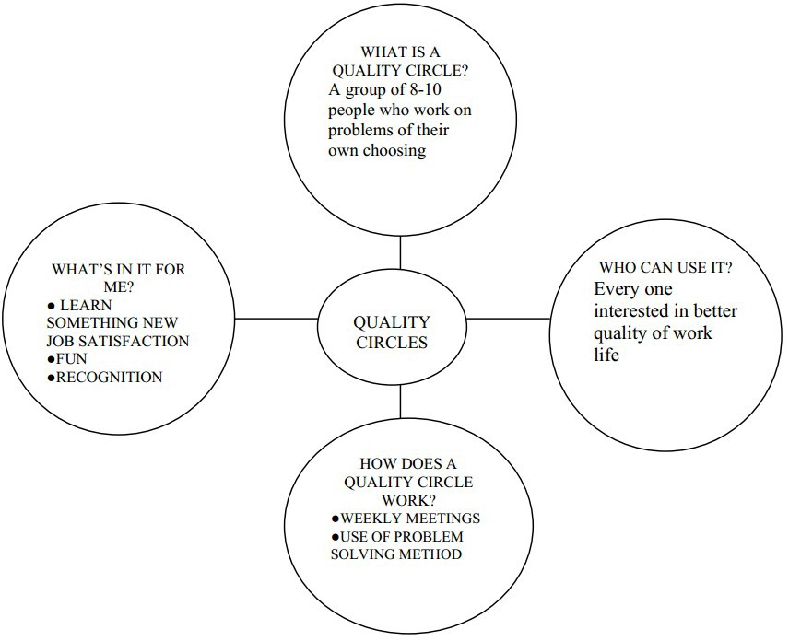

Slide 66
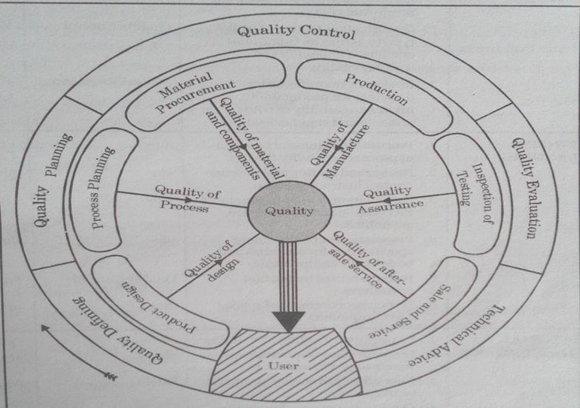
Quality circle (TQM Circle) (CO2)

Slide 67
Recognition and Reward (CO2)
Recognition acknowledges contributions, effort, and adherence to company values, often through informal praise or formal certificates. Rewards are tangible incentives, such as bonuses, gifts, or promotions, given for achieving specific quality goals or benchmarks. Both are essential for increasing employee engagement, improving morale, and aligning individuals with organizational quality objectives

Slide 68

Quality circle (TQM Circle) (CO2)
5S-Kaizen
Kaizen 5S is a Lean Manufacturing methodology that uses five Japanese words starting with 'S' to foster continuous improvement and a more efficient, organized workplace. The five principles are Sort (eliminate unnecessary items), Set in Order (arrange needed items logically), Shine (clean and maintain the area), Standardize (create consistent processes for the first three S's), and Sustain (make the practices a permanent part of the work culture).

Slide 69
Quality circle (TQM Circle) (CO2)
5S-Kaizen
Sort (Seiri):Go through your workspace and remove any clutter, keeping only what is necessary for daily operations.
Set in Order (Seiton):Arrange all necessary items in an organized, logical, and efficient manner so they are easy to find and access.
Shine (Seiso):Clean the workplace and equipment thoroughly, which also helps in inspecting for maintenance issues.
Standardize (Seiketsu):Establish standard procedures and schedules to maintain the first three S's, ensuring consistency.
Sustain (Shitsuke):Make the 5S system a permanent part of the company culture, encouraging ongoing self-discipline to maintain standards.

Slide 70
Quality circle (TQM Circle) (CO2)
5S-Kaizen
Kaizen Connection
Kaizen means "good change" and refers to the ongoing, incremental improvement of processes, products, or services. The 5S methodology is a foundational tool within the larger Kaizen philosophy, as it creates a structured, clutter-free environment from which further continuous improvements can be made

Slide 71
Quality circle (TQM Circle) (CO2)
TQM Gurus
Quality Gurus
Individuals who have been identified as making a significant contribution to improving the quality of goods and services.
Walter A. Shewhart
W. Edwards Deming
Joseph M. Juran
Armand Feigenbaum
Philip Crosby
Genichi Taguchi
Kaoru Ishikawa

Slide 72
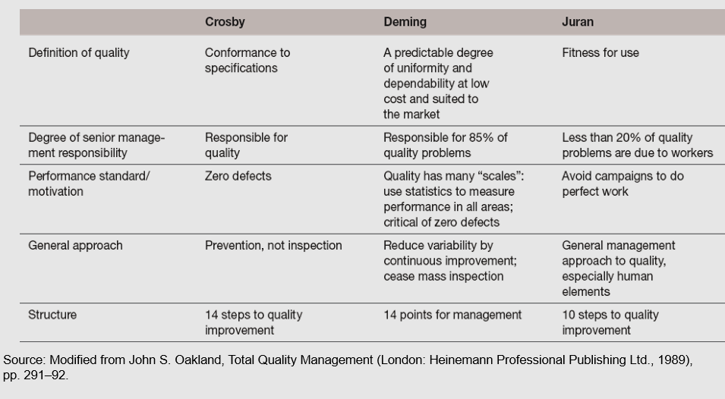
Quality circle (TQM Circle) (CO2)
Three of the Quality Gurus Compared

Slide 73
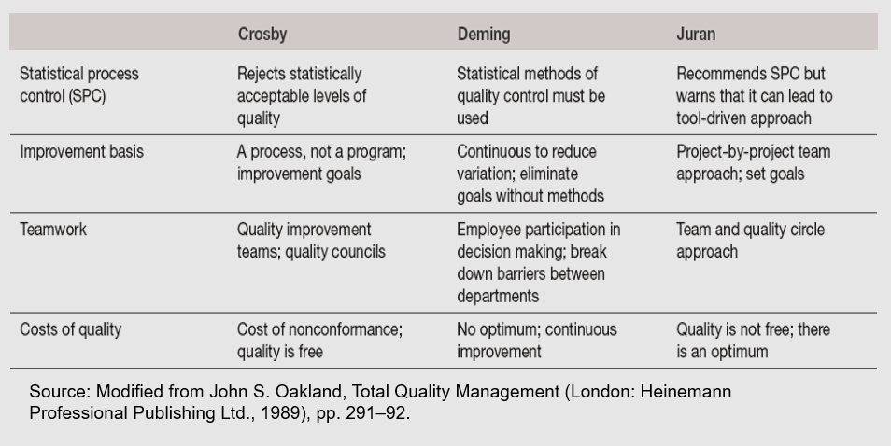
Quality circle (TQM Circle) (CO2)
Three of the Quality Gurus Compared

Slide 74
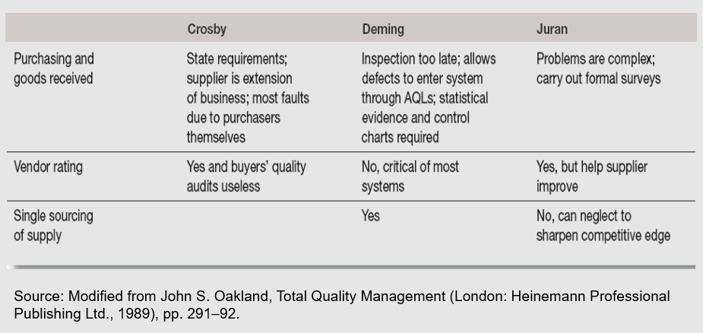
Three of the Quality Gurus Compared

Slide 75
Quality circle (TQM Circle) (CO2)
Quality Gurus (Cont’d)
Walter A. Shewhart
Statistician at Bell Laboratories
Developed statistical control process methods to distinguish between random and nonrandom variation in industrial processes to keep processes under control.
Developed the “plan-do-check-act” (PDCA) cycle that emphasizes the need for continuous improvement.
Strongly influenced Deming and Juran.

Slide 76
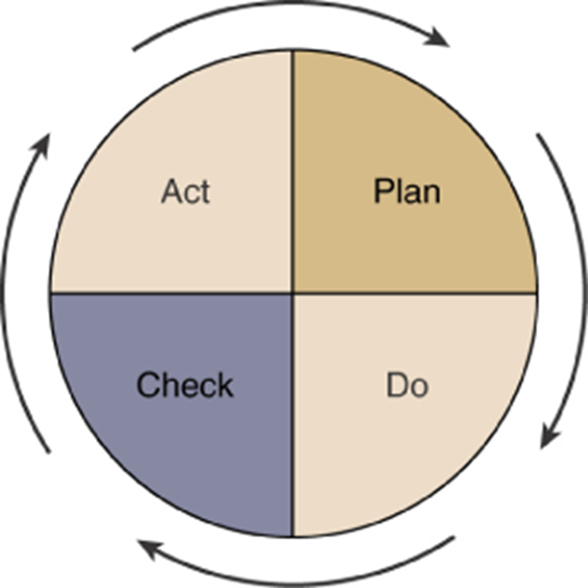
Quality Gurus (Cont’d)
Shewhart’s Plan-Do-Check-Act (PDCA) Cycle

Slide 77
Quality Gurus (Cont’d)
W. Edwards Deming
Advocated Statistical Process Control (SPC)
Methods which signal shifts in a process that will likely lead to products and/or services not meeting customer requirements.
Emphasized an overall organizational approach to managing quality.
Demonstrated that quality products are less costly than poor quality products.
Identified 14 points critical for improving quality.
The Deming Prize
Highest award for industrial excellence in Japan.

Slide 78
Deming’s 14-Point Program for Improving Quality
Quality Gurus (Cont’d)
1. Create constancy of purpose for improvement of product and service.
2. Adopt the new philosophy.
3. Cease dependence on mass inspection.
4. End the practice of awarding business on the price tag alone.
5. Improve constantly and forever the system of production and training.
6. Institute training.
7. Institute leadership.
8. Drive out fear.
9. Break down barriers between staff areas.
10. Eliminate slogans, exhortations, and targets for the workforce.
11. Eliminate numerical quotas.
12. Remove barriers to pride in workmanship.
13. Institute a vigorous program of education and retraining.
14. Take action to accomplish the program.

Slide 79
The Deming philosophy
Quality Gurus (Cont’d)
14 points for management:
Create and publish to all employees a statement of the aims and purposes of the company. The management must demonstrate their commitment to this statement.
Learn the new philosophy.
Understand the purpose of inspection – to reduce the cost and improve the processes.
End the practice of awarding business on the basis of price tag alone.
Improve constantly and forever the system of production and service.

Slide 80
Quality Gurus (Cont’d)
Institute training
Teach and institute leadership.
Drive out fear. Create an environment of innovation.
Optimize the team efforts towards the aims and purposes of the company.
Eliminate exhortations for the workforce.
Eliminate numerical quotas for production.
Remove the barriers that rob pride of workmanship.
Encourage learning and self-improvement.
Take action to accomplish the transformation.

Slide 81
The Deming philosophy
Quality Gurus (Cont’d)
“A System of Profound Knowledge”
Appreciation for a system - A system is a set of functions or activities within an organization that work together to achieve organizational goals. Management’s job is to optimize the system. (not parts of system, but the whole!). System requires co-operation.
Psychology – The designers and implementers of decisions are people. Hence understanding their psychology is important.

Slide 82
The Deming philosophy
Quality Gurus (Cont’d)
Understanding process variation – A production process contains many sources of variation. Reduction in variation improves quality. Two types of variations- common causes and special causes. Focus on the special causes. Common causes can be reduced only by change of technology.
Theory of knowledge – Management decisions should be driven by facts, data and justifiable theories. Don’t follow the managements fads!

Slide 83
Quality Gurus (Cont’d)
Joseph M. Juran
Emphasized the importance of producing quality products through an approach focused on quality planning, control, and improvement.
Defined product quality as “fitness for use” as viewed by the customer in:
Quality of design • Quality of conformance
Availability • Safety • Field use
Categorized the cost of quality as:
Cost of prevention
Cost of detection/appraisal
Cost of failure

Slide 84
The Juran philosophy
Quality Gurus (Cont’d)
Pursue quality on two levels:
The mission of the firm as a whole is to achieve high product quality.
The mission of each individual department is to achieve high production quality.
Quality should be talked about in a language senior management understands: money (cost of poor quality).
At operational level, focus should be on conformance to specifications through elimination of defects- use of statistical methods.

Slide 85
The Juran philosophy
Quality Gurus (Cont’d)
Quality Trilogy –
Quality planning: Process of preparing to meet quality goals. Involves understanding customer needs and developing product features.
Quality control: Process of meeting quality goals during operations. Control parameters. Measuring the deviation and taking action.
Quality improvement: Process for breaking through to unprecedented levels of performance. Identify areas of improvement and get the right people to bring about the change.

Slide 86
Quality Gurus (Cont’d)
Armand Feigenbaum
Proposed the concept of “total quality control,” making quality everyone’s responsibility.
Stressed interdepartmental communication.
Emphasized careful measurement and report of quality costs
Philip Crosby
Preached that “quality is free.”
Believed that an organization can reduce overall costs by improving the overall quality of its processes.

Slide 87
The Crosby philosophy
Quality Gurus (Cont’d)
Absolute’s of Management
Quality means conformance to requirements not elegance.
There is no such thing as quality problem.
There is no such thing as economics of quality: it is always cheaper to do the job right the first time.
The only performance measurement is the cost of quality: the cost of non-conformance.
Basic Elements of Improvement
Determination (commitment by the top management)
Education (of the employees towards Zero Defects (ZD))
Implementation (of the organizational processes towards ZD)

Slide 88
Quality Gurus (Cont’d)
Genichi Taguchi
Emphasized the minimization of variation.
Concerned with the cost of quality to society.
Extended Juran’s concept of external failure.
Kaoru Ishikawa
Developed problem-solving tools such as the cause-and-effect (fishbone) diagram.
Called the father of quality circles.

Slide 89
FACULTY VIDEO LINKS, YOUTUBE & NPTEL VIDEO LINKS AND ONLINE COURSES DETAILS
https://www.youtube.com/watch?v=Q3EOCAuExJU
https://www.youtube.com/watch?v=yWlAOFs04go
https://www.youtube.com/watch?v=QifqIoUNTJM
https://www.youtube.com/watch?v=qb3mvJ1gb9g
https://www.youtube.com/watch?v=2ePeXePNLrs
https://www.youtube.com/watch?v=HkdoR-NNEoI
https://www.researchgate.net/publication/318654507_Total_Quality_Management_Notes
http://www.mescenter.ru/images/abook_file/Total_Quality_Management_and_Six_Sigma.pdf

Slide 90
DAILY QUIZ
What do you understand by quality audit?
Briefly explain the term TQM?
Explain the different Dimensions of Quality?
Give the Basic Concepts of TQM?
Give the Principles of TQM?

Slide 91
WEEKLY ASSIGNMENT
Discuss the importance of quality culture?
Explain the difference between traditional and modern quality cultures?
How do you understand who is a customer?
Explain customer defined value, value analysis and retention.
Discuss product innovation models for customer retention?
Discuss employee empowerment?
Discuss leadership for quality?
Explain why continual quality improvement is important.

Slide 92

What is the aim of fool proof technique used for total quality management?
a. to achieve zero defects b. to specify time schedules c. to specify targets d. none of the above
Match the following group 1 items with group 2 items 1. Sort -------------------------------------------------- A. Seitan 2. Set in order -----------------------------------------B. Seiketsu 3. Shine ------------------------------------------------ C. Seiri 4. Standardize -----------------------------------------D. Seiso
a. 1 – D, 2 – A, 3 – B, 4 – C b. 1 – C, 2 – A, 3 – D, 4 – B c. 1 – B, 2 – C, 3 – A, 4 – D d. 1 –A, 2 – C, 3 – D, 4 – B

Slide 93
MCQs
MCQ
MCQs
Which quality management program is related to the maintenance of plants and equipments?
a. Environmental management systems b. Fault tree analysis c. Failure mode effect analysis d. Total productive maintenance
Which part in quality management is the critical part? a) Process thinking b) Performance measurement c) Customer’s view d) Systematic approach
MCQs

Slide 94
What is the full form of TQM? a) True quality machining b) Total quality management c) True quantitative machining d) Total queue management
Which of the following is correct for TQM? a) Quality strategy in TQM emanates from top b) TQM is a static process c) It is a management approach to short-term success through customer d) It is used to improve processes not products

Slide 95
Which factor is the basis of Decision making in TQM? a) Facts only b) Opinions only c) Facts and opinions both d) Neither facts nor opinions
According to Deming, Quality problems are
a. Due to management
b. Due to method
C . Due to machine
d. Due to material

Slide 96
Which factor is the basis of Decision making in TQM? a) Facts only b) Opinions only c) Facts and opinions both d) Neither facts nor opinions
According to Deming, Quality problems are
a. Due to management
b. Due to method
C . Due to machine
d. Due to material

Slide 97
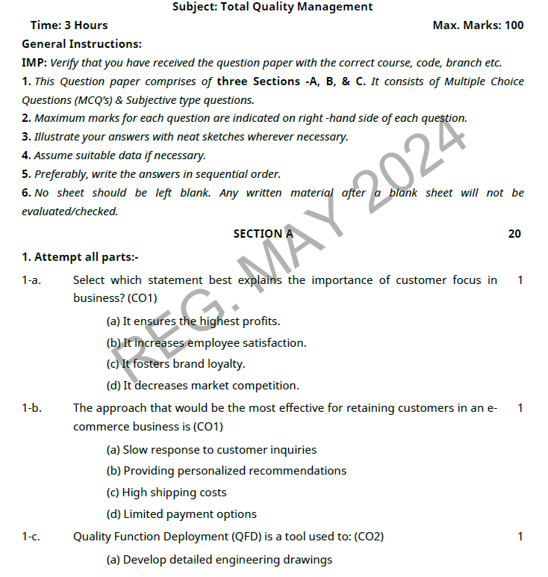
OLD QUESTION PAPERS

Slide 98
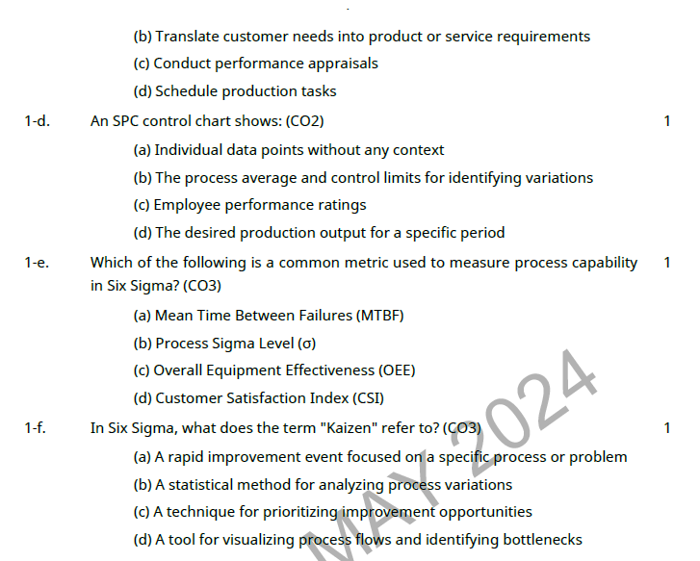
OLD QUESTION PAPERS

Slide 99
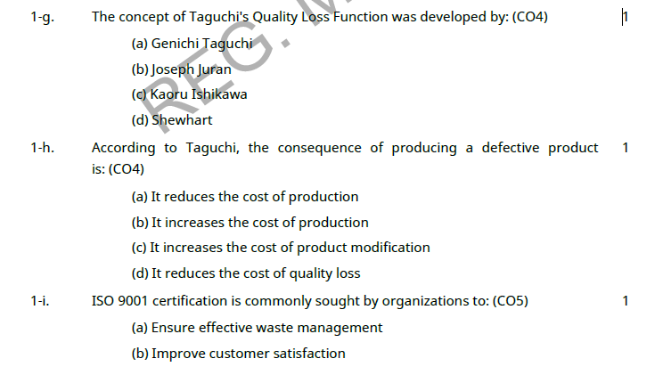
OLD QUESTION PAPERS

Slide 100
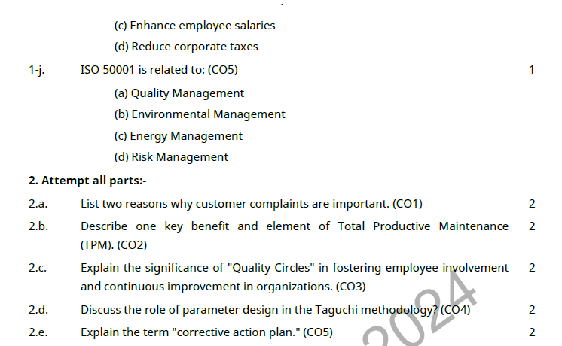
OLD QUESTION PAPERS

Slide 101
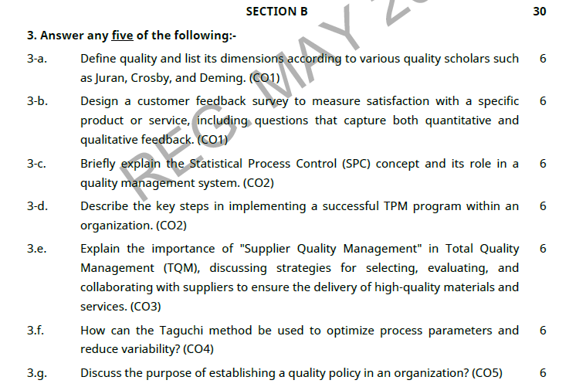
OLD QUESTION PAPERS

Slide 102
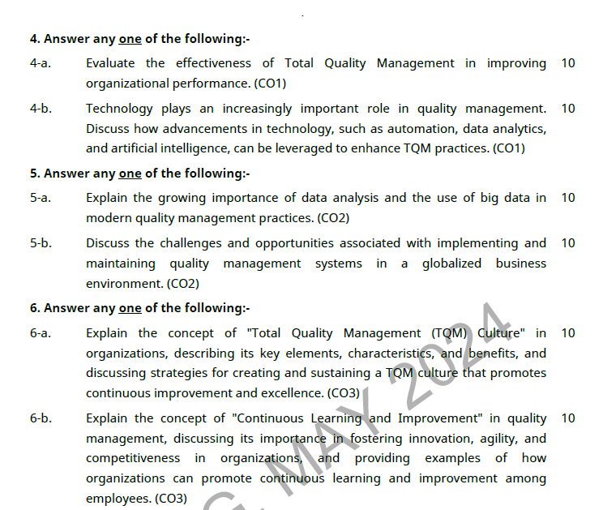
OLD QUESTION PAPERS

Slide 103
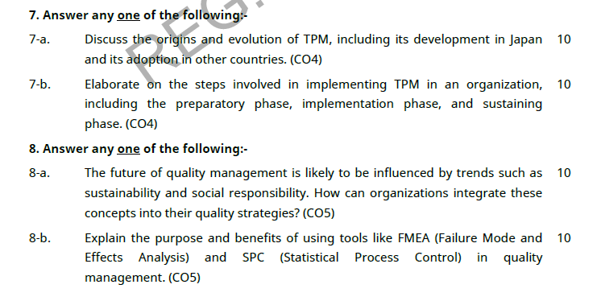
OLD QUESTION PAPERS

Slide 104
EXPECTED QUESTIONS FOR UNIVERSITY EXAM
Explain the implementation and documentation of Quality System? Implementation steps.
Explain the Benefits of ISO 14000?
Why is ISO 9000 important?
What are the objectives of reliability and how we can evaluate for a product?
State the objectives and benefits of JIT.
Explain the step followed to get ISO 9000 certification for educational institute.

Slide 105
Expected Questions for University Exam
Explain the different Dimensions of Quality?
Give the Basic Concepts of TQM?
Give the Principles of TQM?
Explain the Obstacles associated with TQM Implementation?
What is needed for a leader to be effective?
What are the general duties of a quality council?
Explain the important factors that influence customer purchases?

Slide 106
EXPECTED QUESTIONS FOR UNIVERSITY EXAM
Expected Questions for University Exam
EXPECTED QUESTIONS FOR UNIVERSITY EXAM
What are the types of teams?
What are the stages of team development?
Give some common team problems?
Give the steps involved in training process?
What are the three components of the Juran Trilogy?
What are the phases of a Continuous Process Improvement Cycle?

Slide 107


TQM encourages participation amongst employees, managers and organization as whole.
Using Quality management reduces rework nearly to zero in an achievable goal .The responsibilities either its professional, social, legal one that rest with the pharmaceutical manufacturer for the assurance of quality of product are tremendous and it can only be achieved by well organised.
Work culture and complete engagement of the employees at the work place. It should be realised that national & international regulations must be implemented systematically and process.
Control should be practiced rigorously.

Slide 108
SUMMARY
SUMMARY
Summary
Thus quality is critically important ingredient to organizational success today which can be achieved by TQM, an organizational approach that focuses on quality as an over achieving goals, aimed at aimed at the prevention of defects rather than detection of defects

Slide 109

Text Book
Lt. Gen. H. Lal, “Total Quality Management”, Eastern Limited
Greg Bounds, “Beyond Total Quality Management”, McGraw Hill
Menon, H.G, “TQM in New Product manufacturing”, McGraw Hill
Reference Book
Total Quality Management” by Besterfield
“Total Quality Management” by Mukherjee
Total Quality Management” by Vijayan
“Total Quality Management- Text and Cases” by Janakiraman B and Gopal R K
https://www.researchgate.net/publication/318654507_Total_Quality_Management_Notes

Slide 110
Thank You

